Slide 1
SYNCHRONOUS COUNTER DESIGN
CME 2003
Digital Logic
Şerife SUNGUN

Slide 2
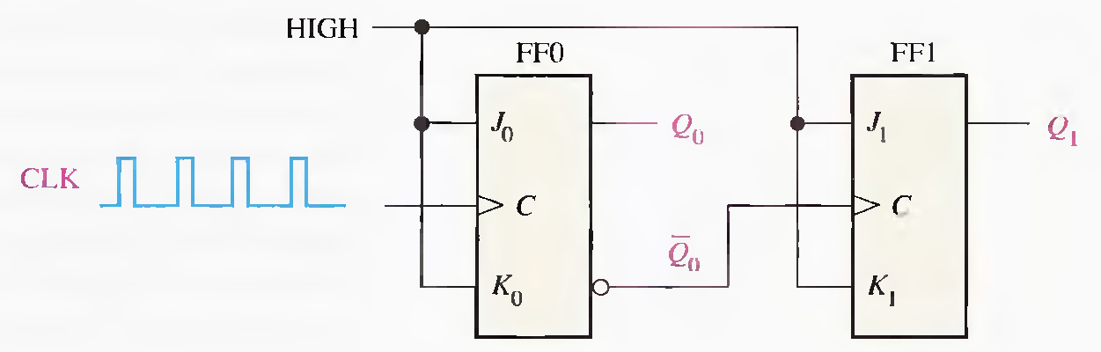
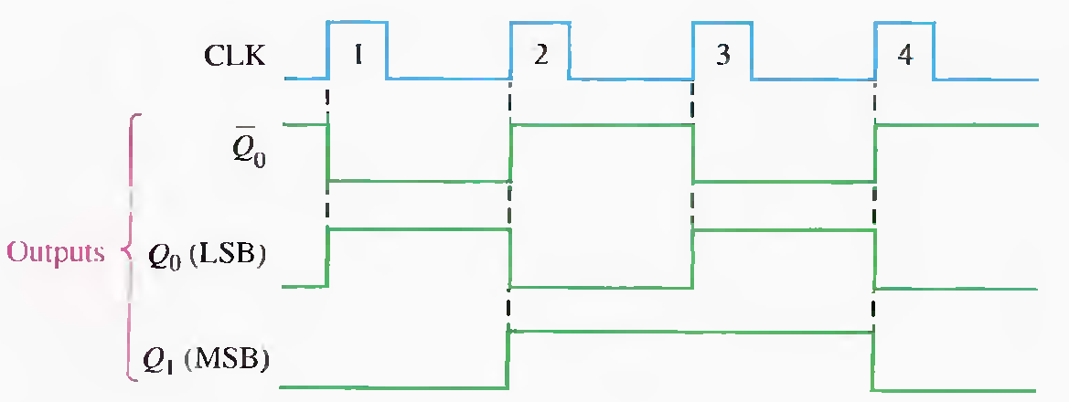
2-Bit Asynchronous Binary Counter
DEU CSE
Şerife SUNGUN

Slide 3
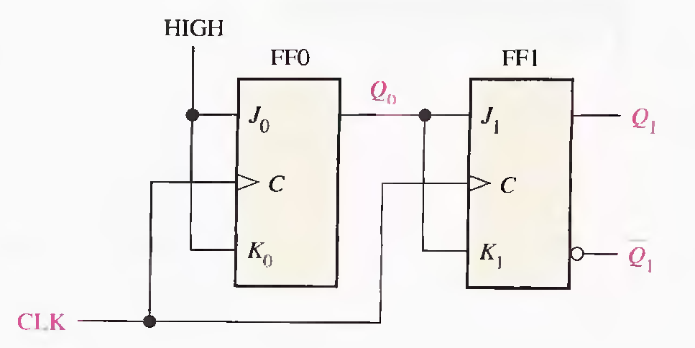
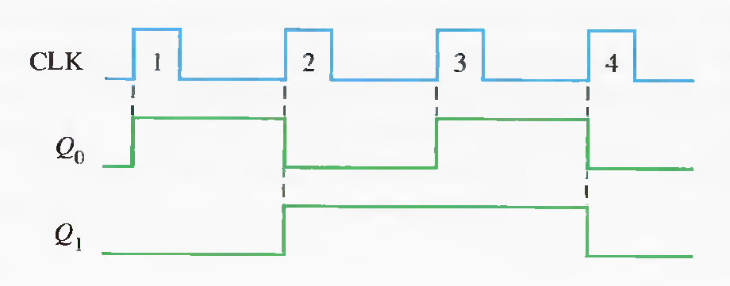
2-Bit Synchronous Binary Counter
DEU CSE
Şerife SUNGUN

Slide 4
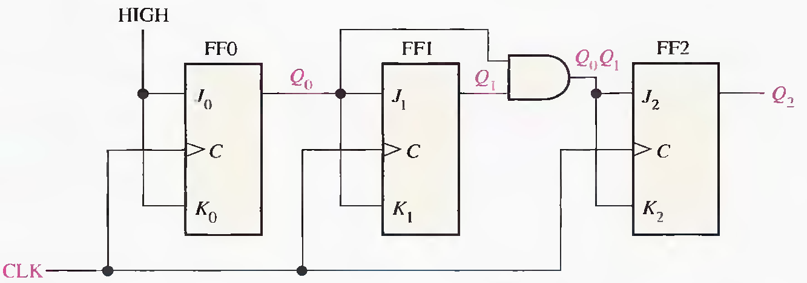
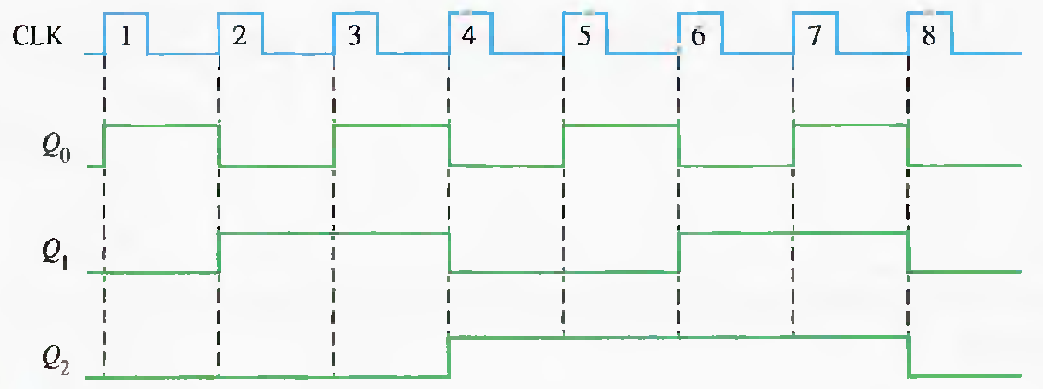
3-Bit Synchronous Binary Counter
DEU CSE
Şerife SUNGUN

Slide 5
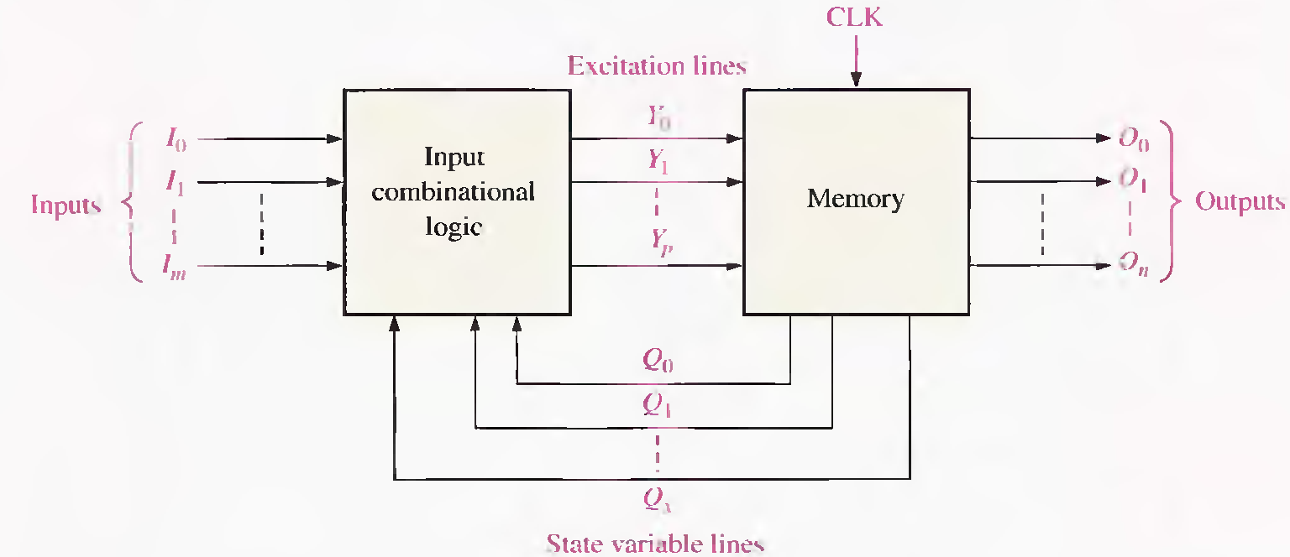
Design of Synchronous Counters
DEU CSE
Şerife SUNGUN

Slide 6
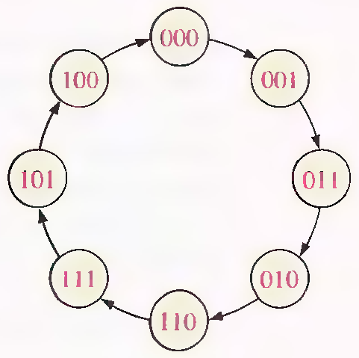
Step 1: State Diagram
A state diagram shows the progression of states through which the counter advances when it is clocked.
Example: State diagram for a 3-bit Gray code counter.
DEU CSE
Şerife SUNGUN

Slide 7
Step 2: Next-State Table
a next-state table lists each state of the counter (present state) along with the corresponding next state.
the next state is the state that the counter goes to from its present State upon application of a clock pulse
DEU CSE
Şerife SUNGUN

Slide 8
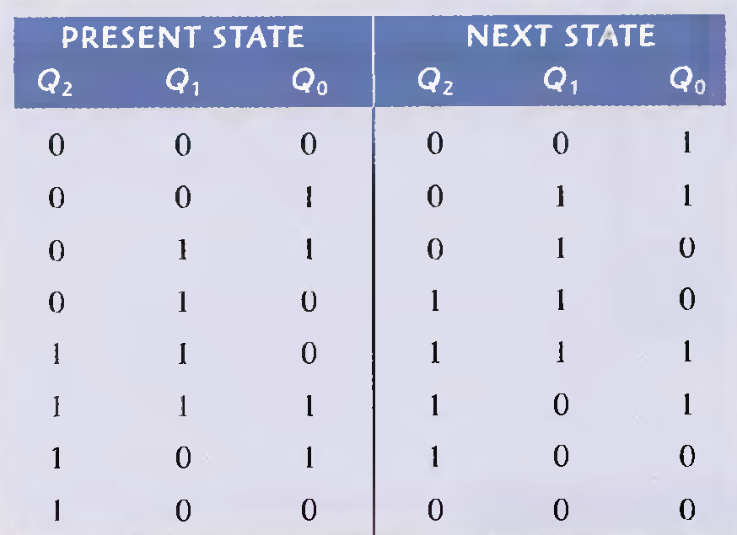
Next State Table for 3-bit Gray Code
DEU CSE
Şerife SUNGUN

Slide 9
Step 3: Flip-Flop Transition Table
All possible output transitions are listed by showing the Q output of the flip-flop going from present states to next states.
Q_{N} is the present state of the flip-flop (before d clock pulse) and Q_{N+1} is the next state (after a clock pulse).
For each output transition. the J and K inputs that will cause the transition to occur are listed.
An X indicates a "don't care" (the input can be either a 1 or a 0).
DEU CSE
Şerife SUNGUN

Slide 10
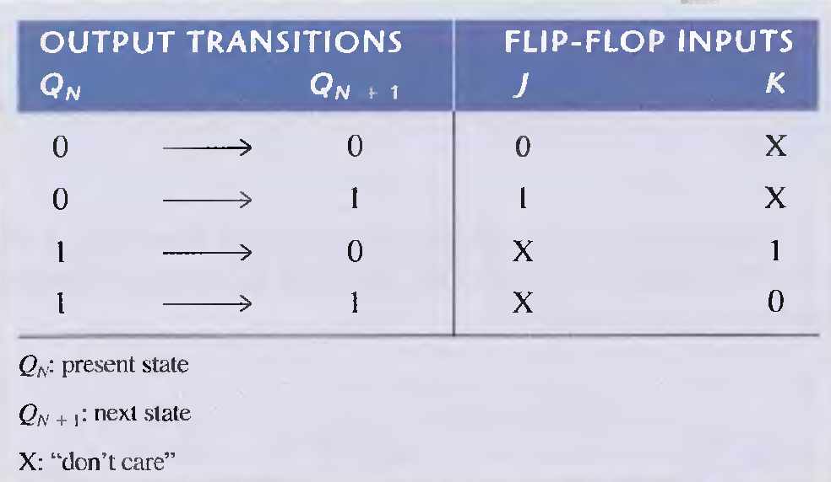
Transition table for a J-K flip-flop
DEU CSE
Şerife SUNGUN

Slide 11
Step 4: Karnaugh Maps
Karnaugh maps can be used to determine the logic required for the J and K inputs of each flip-flop in the counter.
There is a Karnaugh map for the J input and a Kamaugh map for the K input of each flip-flop.
each cell in a Kamaugh map represents one of the present states in the counter sequence.
DEU CSE
Şerife SUNGUN

Slide 12
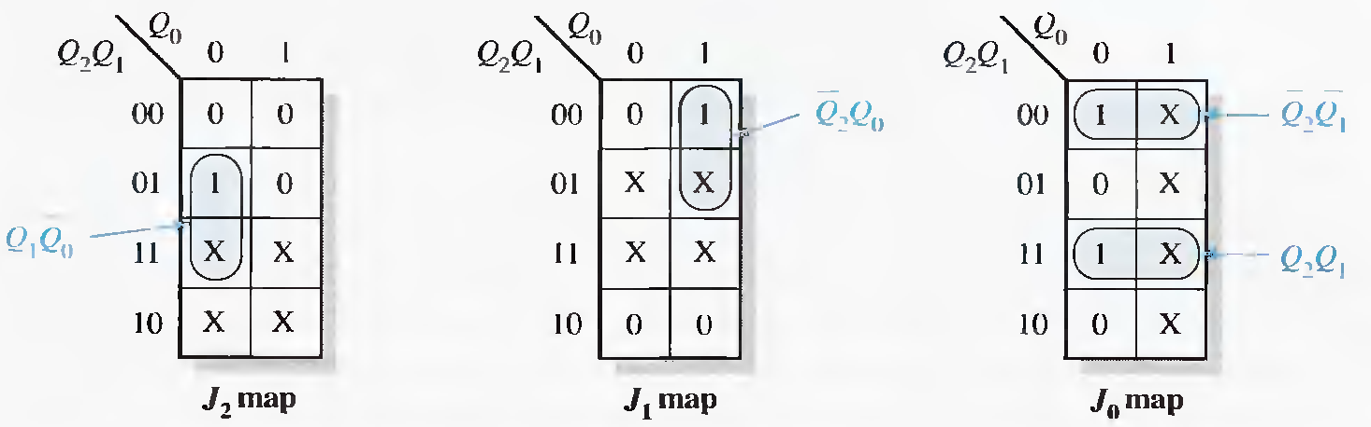
Karnaugh maps for present-state J input
DEU CSE
Şerife SUNGUN

Slide 13
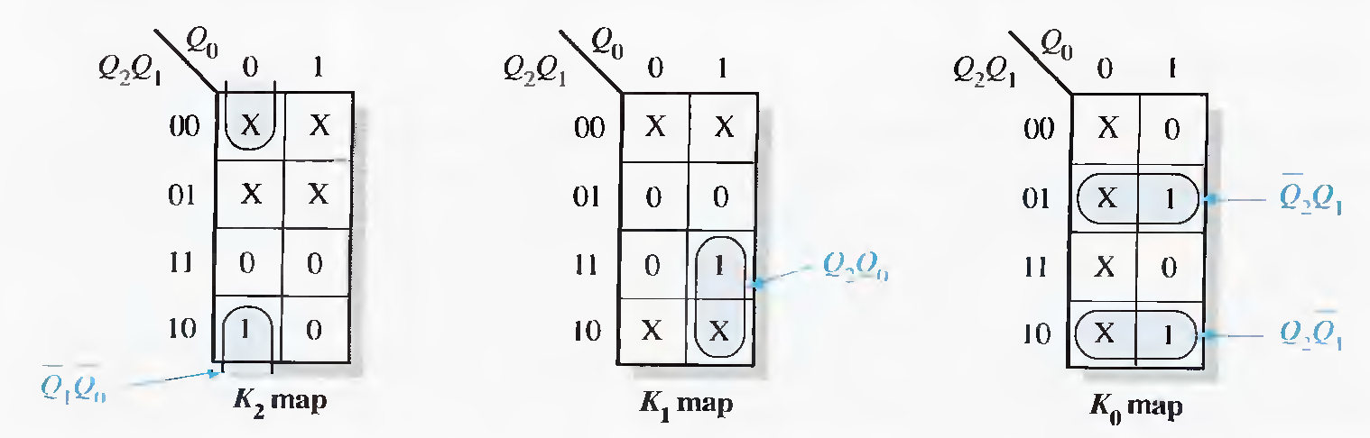
Karnaugh maps for present-state K input
DEU CSE
Şerife SUNGUN

Slide 14
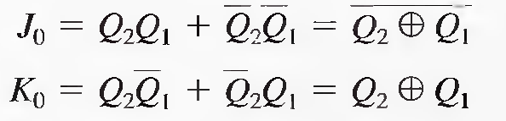
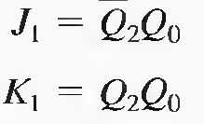

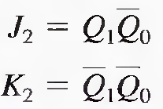
Step 5: Logic Expressions for Flip-Flop Inputs
the following expressions for the J and K inputs of each flip-flop obtained from the Karnaugh maps
DEU CSE
Şerife SUNGUN

Slide 15
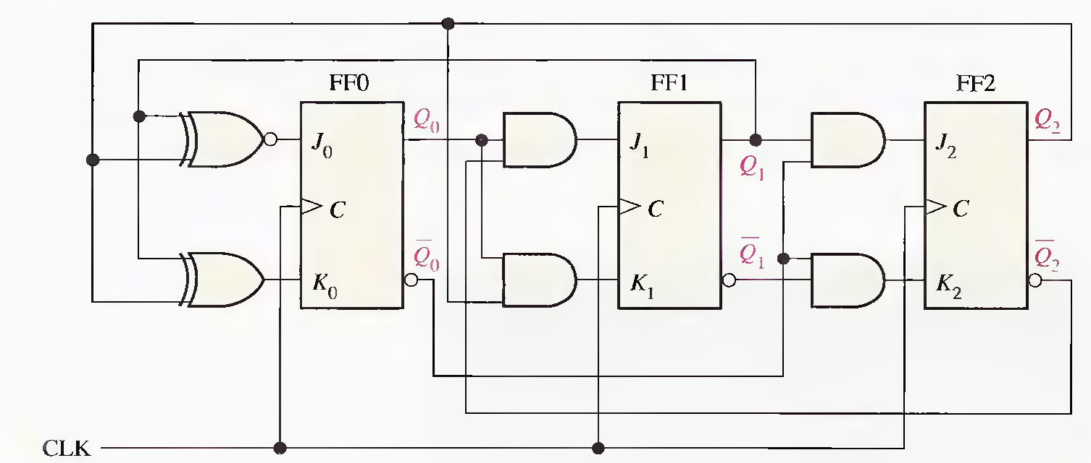
Step 6: Counter Implementation
DEU CSE
Şerife SUNGUN

Slide 16
A summary of steps used in the design of a synchronous counter.
Specify the counter sequence and draw a state diagram.
Derive a next-state table from the state diagram.
Develop a transition table showing the flip-flop inputs required for each transition. The transition table is always the same for a given type of flip-flop.
Transfer the J and K states from the transition table to Karnaugh maps. There is a Karnaugh map for each input of each flip-flop.
Group the Karnaugh map cells to generate and derive the logic expression for each flip-flop input.
implement the expressions with combinational logic. and combine with the flip- flops to create the counter.
DEU CSE
Şerife SUNGUN

Slide 17

State Transition
Diagram
State Transition Table
EXAMPLE
Synchronous Counter Implementation Using J-K FFs
Present State
Next State
000 110
010 101
011
C B A C⁺ B⁺ A⁺
0 0 0 0 1 0
0 0 1 x x x
0 1 0 0 1 1
0 1 1 1 0 1
1 0 0 x x x
1 0 1 1 1 0
1 1 0 0 0 0
1 1 1 x x x
State Transition Table and Remapped Next-State Functions
Present
State
Next
State
Remapped Next
State
C B A C⁺ B⁺ A⁺ JC KC JB KB JA KA
0 0 0 0 1 0 0 x 1 x 0 x
0 0 1 x x x x x x x x x
0 1 0 0 1 1 0 x x 0 1 x
0 1 1 1 0 1 1 x x 1 x 0
1 0 0 x x x x x x x x x
1 0 1 1 1 0 x 0 1 x x 1
1 1 0 0 0 0 x 1 x 1 0 x
1 1 1 x x x x x x x x x
J-K Flip-Flop Excitation Table
Q Q⁺ J K
0 0 0 x
0 1 1 x
1 0 x 1
1 1 x 0
DEU CSE
Şerife SUNGUN

Slide 18
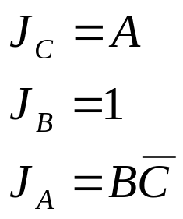
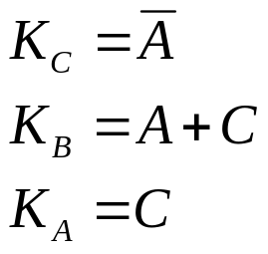
Next State Functions
Remapped K-Maps for J-K Implementation.
CB
CB
A
00 01 11 10
A
00 01 11 10
x x 1 x
x x x 0
0
0 0 x x
x 1 x x
J_{C}
0
K_{C}
1
1
CB
CB
A
00 01 11 10
A
00 01 11 10
0
1 x x x
x x x 1
0
x 0 1 x
x 1 x x
J_{B}
K_{B}
1
1
CB
CB
A
00 01 11 10
A
00 01 11 10
0
0 1 0 x
x x x x
J_{A}
0
x x x x
x 0 x 1
K_{A}
1
1
DEU CSE
Şerife SUNGUN

Slide 19



J-K Flip-Flop Implementation of 3 Bit Counter
+
C
B
J_{A}
A
A
J Q
CLK
K Q
J Q
CLK
K Q
J Q
CLK
K Q
K_{B}
C
CLOCK
A
B
K_{B}
J_{A}
C
DEU CSE
Şerife SUNGUN

